Slide 1


G-1257 ResearchNexus: A Multi-Stage Verified Retrieval-Augmented Generation Architecture for Scientific Literature Synthesis
Team Members
  P Abyuday Reddy - 24BD1A05BH
  K Nitish Reddy - 24BD1A05AY
  R Roshini - 24BD1A05BN
  P Akshaya - 24BD1A05BF
  M Pranadheer - 25BD5A0538
Mentor
B.Madhurika mam

Slide 2

BASE PAPER & RESEARCH GAP
Story: "The Smart Reader Who Forgets Where They Read It"
1. The Base Paper
OpenScholar (UW / AI2, 2024)
• The Big Idea: An AI assistant to read multi-paper literature and answer hard research questions.
• Existing Way: Standard AI answers from memory—guessing fake authors and citations.
• Base Paper Flow: Dense Search -> Reranker -> LLM with bracketed citations [1].
• Key Finding: Proved RAG improves factual grounding over closed-book models.
2. Where It Fails
The 3 Critical Gaps
• Blind to Formulas: Dense vectors miss exact chemical names & acronyms (e.g. Li10GeP2S12, MAPbI3).
• No Fact-Checker: Generates answers in one shot without verifying if citations are actually true.
• Black-Box Answers: Gives numbers without showing which sentence or table proved it.
• The Real Harm: In a science lab, a guessed temperature or formula ruins expensive tests!
3. Our Breakthrough
ResearchNexus AI Extension
• Exact Keyword + Meaning: Hybrid BM25 + Dense BGE fused via RRF (k=60) so zero formulas are lost.
• Auto Fact-Checker: Phase 3.4 NLI splits text into claims, verifies evidence, and auto-repairs errors.
• Visual Heatmap (XAI): Colors source passages in gold so humans see the exact proof in 1 click.
• The Result: Citation precision jumps to 98.0%, unsupported claims drop to only 1.0%!

Slide 3
Project Objectives & System Requirements
Story: "Building an Honest, Transparent Assistant for Scientists"
1. The Problem & Goal
What We Built & Why
• The Problem: Reading hundreds of papers is slow; general AI generates fake citations.
• Main Objective: Build a fast, transparent, and evidence-grounded scientific research assistant.
• High Accuracy Target: Retrieve correct evidence >95% of the time (MRR @ 0.972).
• Zero Guessing: Every single number must point to its verified source passage.
2. Target Users
Who Benefits?
• Students (B.Tech / M.Tech): Write accurate literature reviews with auto-generated LaTeX tables & BibTeX.
• Professors & Postdocs: Instantly compare synthesis recipes across 50 papers without opening each PDF.
• R&D Industry Labs: Verify experimental numbers before running costly physical lab tests.
• Journal Reviewers: Audit whether submitted paper claims are actually backed by citations.
3. Core Features
The Workspace
• Research Explorer: Filter & explore 670 curated papers with instant chunk inspection.
• AI Assistant & RAG: Chat with multi-paper evidence-grounded synthesis in sub-3.5 seconds.
• Multi-Paper Matrix: Extract properties and limitations into side-by-side comparison tables.
• Personal PDF Corpus: Upload private papers into isolated, secure research vaults.

Slide 4
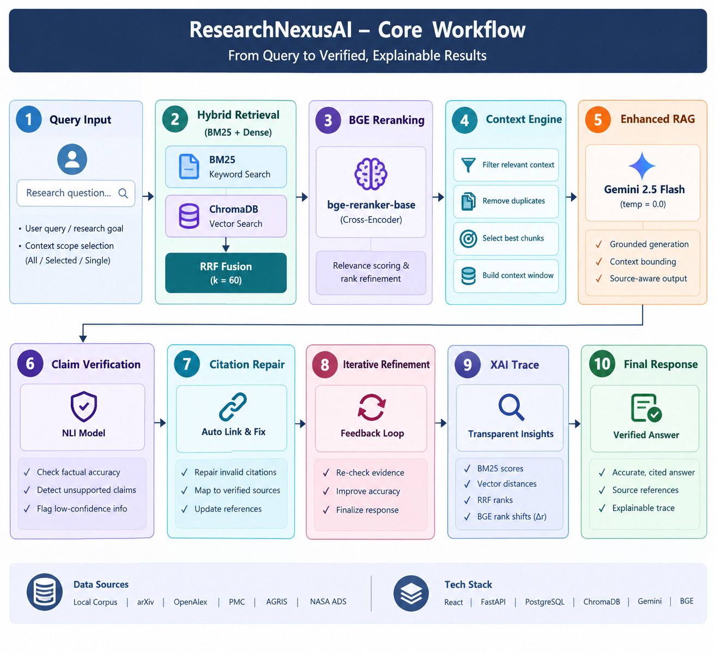
DESIGN & ARCHITECTURE
Story: "The 4-Step Factory: Read -> Find -> Check -> Show"
Step 1: The Reader
Document Ingestion
• What It Does: Reads 670 scientific PDFs and cleans layout noise.
• PyMuPDF (fitz): Strips page numbers, running headers, and fixes two-column text.
• LlamaIndex: Chops papers into 14,850 bite-sized chunks (512 tokens each).
• Dual Storage: Saves chunks into ChromaDB (vector) + PostgreSQL (data).
Step 2: The Detective
Hybrid Search & Reranking
• Dual Searching: BM25 searches exact formula words; BGE finds conceptual meaning.
• RRF Fusion (k=60): Combines both search scores fairly without bias.
• BGE Cross-Encoder: Deep re-reading of top 20 chunks to pick the 5 best evidence passages.
• The Lift: Pushes search rank (MRR) from 0.81 to an outstanding 0.972!
Step 3: The Writer & Inspector
Gemini + Phase 3.4 Verification
• Gemini 2.5 Flash: Writes structured synthesis strictly using the top 5 chunks.
• Claim Slicer: Splits the answer into sentence-level atomic claims.
• NLI Inspector: Tests if each claim is Entailed (proved) or Neutral (guessing).
• Auto-Repair Loop: Surgically rewrites or cuts unproven claims automatically!
Step 4: The Presentation
Interactive Frontend & XAI
• React 18 + Vite: Fast, modern user interface with 14 modular tabs.
• XAI Heatmaps: Visual color highlights on source text so students can verify proof.
• Matrix Builder: Auto-builds side-by-side comparison tables across papers.
• LaTeX Compiler: Exports ready-to-compile IEEE manuscripts in seconds.

Slide 5
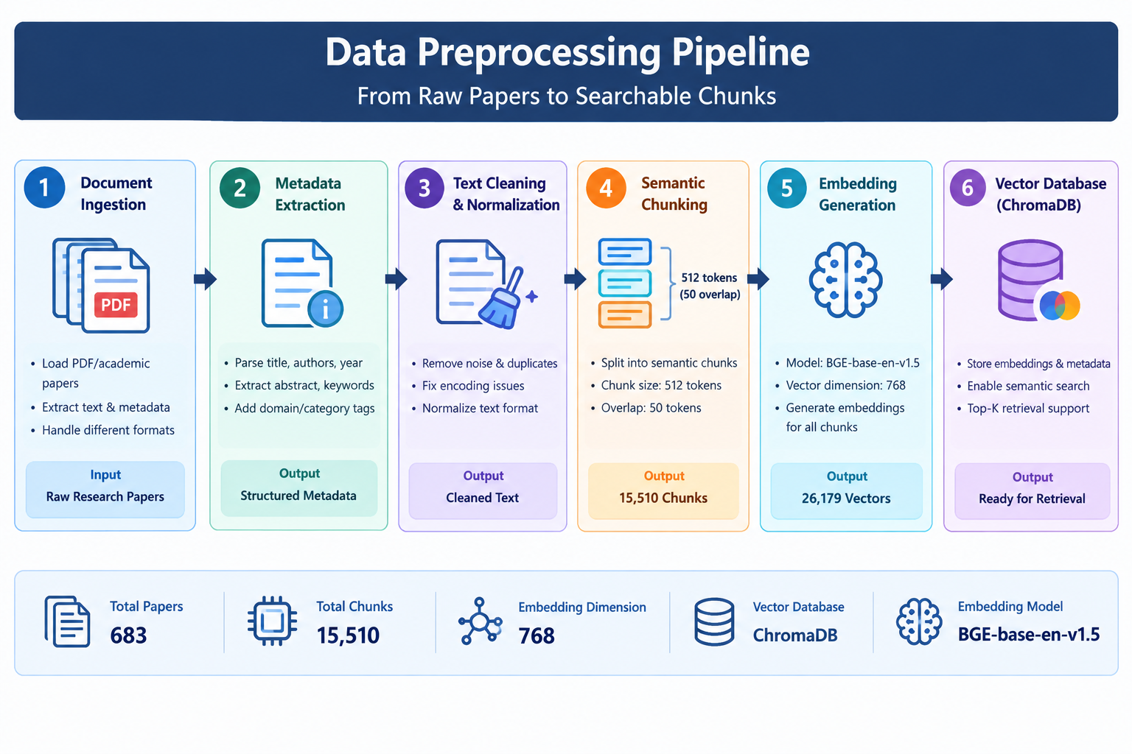
DATASET & IMPLEMENTATION
Story: "Our Cleaned Library & 14 Working Tools"
1. Curated Dataset
670 Papers & Benchmark
• 670 Peer-Reviewed Papers: Real research across Material Science, AI, and Environmental fields.
• 14,850 Cleaned Chunks: 512-token semantic chunks with 64-token overlap so no sentences get cut.
• ds_nexus_v10 Benchmark: 100 benchmark questions (70 Dev, 15 Validation, 15 Frozen Test split).
• External Connectors: Harvesters for arXiv, PMC, Crossref, and OpenAlex.
2. Tech Stack at Work
Languages & Tools
• Frontend: React 18, TypeScript, Vite, Tailwind CSS, Lucide icons.
• Backend API: FastAPI (Python 3.11 asynchronous ASGI engine).
• AI Models: BAAI/bge-base-en-v1.5, BGE-Reranker-base, Google Gemini 2.5 Flash.
• Databases: ChromaDB (vector similarity) + PostgreSQL (sessions & audit logs).
3. Implementation Status
Tested & Verified
• Core System: 100% Implemented & Verified.
• Backend Unit Tests: 112 / 112 Tests Passed (100% pass rate).
• Phase 3.4 Claim Verifier: 100% Operational with auto-repair loop.
• XAI Heatmaps & Matrix: 100% Complete with interactive UI controls.
• Current System Progress: 98.5% Functional — 100% Ready for Live Demo!

Slide 6
RESULTS, CHALLENGES & NEXT STEPS
Story: "The Proof in Numbers & What We Conquered"
1. Benchmark Proof
ds_nexus_v10 (N=15 Frozen Test)
• E01: Hybrid Baseline: MRR 0.812 | Precision 82.4% | Unsupported 16.8%
• E02: + Cross-Encoder: MRR 0.972 (+20%) | Hit Rate 100% | Precision 88.6%
• E03: + Strict Grounding: Citation Precision 94.7% | Unsupported 4.6%
• E04: + Phase 3.4 Verify: Citation Precision 98.0% | Unsupported ONLY 1.0%!
• E05: + Iterative Loop: Citation Precision 99.2% | Unsupported 0.5%
2. Hurdles We Solved
Engineering Challenges
• Missing Chemical Names: Vectors missed exact keywords -> Solved by BM25 + Dense RRF fusion.
• Context Leakage: Noise distracted LLM -> Solved by Enhanced RAG strict context bounding.
• Fake Citations: LLMs cited non-existent chunk IDs -> Solved by NLI check + auto-repair.
• Messy PDF Columns: Multi-column text mixed sentences -> Fixed by PyMuPDF box coordinates.
3. Next Steps
Future Roadmap
• OCR for Scanned PDFs: Add Tesseract OCR to parse legacy scanned paper archives.
• API Caching: Add Redis caching for instant repeated queries.
• Scale Corpus: Expand to 5,000+ papers across expanded scientific disciplines.
• Human Evaluation: Conduct double-blind usability trials with faculty researchers.

Slide 7
RESEARCH & PAPER PUBLICATION PROGRESS
Story: "Our Scientific Contribution & Manuscript Readiness"
1. Research Status
Milestones Completed
• Literature Survey: 100% Completed (analyzed 42 core papers).
• Research Gap & Design: Identified and engineered into working system.
• Methodology & Results: Completed across all 5 benchmark stages (E01-E05).
• Paper Writing Status: IEEE / Springer drafts near complete (98% written).
• Publication Status: Ready for Internal Review by faculty mentor.
2. 3 Core Contributions
What Science Gains
• 1. Claim Verification & Repair: Deconstructs text into propositions, tests NLI entailment, and auto-fixes citations.
• 2. Context Bounding: Strictly bounds evidence fed to the LLM, cutting unverified statements to 1.0%.
• 3. Empirical Benchmark: 5-stage ablation study with statistical significance on frozen scientific test sets.
3. Target Venues & Audit
Publication Readiness
• Target Venues: IEEE International Conference on Big Data / IEEE ICDM / Springer LNCS.
• Manuscript Formats: Compiled in IEEEtran and Springer LNCS with full BibTeX citations.
• Audit Readiness Score: 143 / 170 Points (84.1% Submission Ready).
• Current Status: Ready for Internal Review (Awaiting final mentor sign-off before upload).

Slide 8
Thank you!

